Slide 1



GROUP 5
CONCERT TICKET SALES
WEB APPLICATION

Slide 2





GROUP
MEMBER
Fathon
Mutia
Salwa

Slide 3








LIST OF
CONTENT
Introduction
Process
Background
Result
Project Goals
Conclusion

Slide 4


BACK
GROUND
As live entertainment becomes more popular, concert ticket sales become increasingly important.
However, the ticket sales process is often inefficient, resulting in long queues, limited access and the risk of fraud.
To overcome these challenges, developing an application to sell concert tickets is a promising solution.

Slide 5
SYSTEM ANALYST
System analysis of this project using the Javascript, CSS, JSP, and HTML programming system. The goal of this project is to create a system on the web in the form of purchasing concert tickets, which aims to make it easier for visitors who want to buy concert tickets but do not have to buy on the spot.

Slide 6

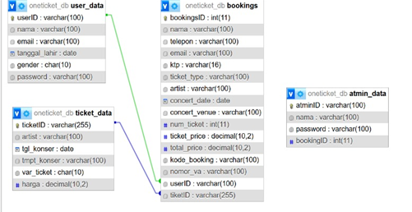
ERD
TABLE

Slide 7
RUNNING
Next run the project in the Apache Netbeans and MySQL

Slide 8

ANY
QUESTION

Slide 9

THANK
YOU

